Slide 1
Temporal climate downscaling
Ana I. Ayala
2026-04-14

Slide 2
Method 1: (GRNN-based approach, following Ayala et al., 2020 https://doi.org/10.5194/hess-24-3311-2020
$$\left(T_{air, h}, {RH}_{h}, {SWR}_{in, h}, {WS}_{h}, {Pr}_{h}\right)=f\left(T_{air, d}, {RH}_{d}, {SWR}_{in, d}, {WS}_{d}, {Pr}_{d}, \sin\left(h\right), \cos\left(h\right),\sin\left(doy\right), \cos\left(doy\right), daylight_{flag,h}, t_{sunrise,h}, t_{sunset,h}, ω_{h}\right)$$
 |  | RMSE | R | NSE
Tair (°C) | Train | 0.1841 | 0.9997 | 0.9994
 | Test | 1.4350 | 0.9858 | 0.9718
RH (%) | Train | 1.3719 | 0.9971 | 0.9940
 | Test | 6.3331 | 0.9364 | 0.8748
SWRin (W/m2) | Train | 19.7664 | 0.9944 | 0.9884
 | Test | 47.1882 | 0.9682 | 0.9373
WS (m/s) | Train | 0.2395 | 0.9948 | 0.9890
 | Test | 1.1436 | 0.8646 | 0.7447
Pr (mm/h) | Train | 0.2219 | 0.8043 | 0.6185
 | Test | 0.3179 | 0.6673 | 0.4375
Notes:
Lake Erken
For each hour: daylight flag (0: night, 1: day), time since sunrise , time until sunset, hour angle

Slide 3
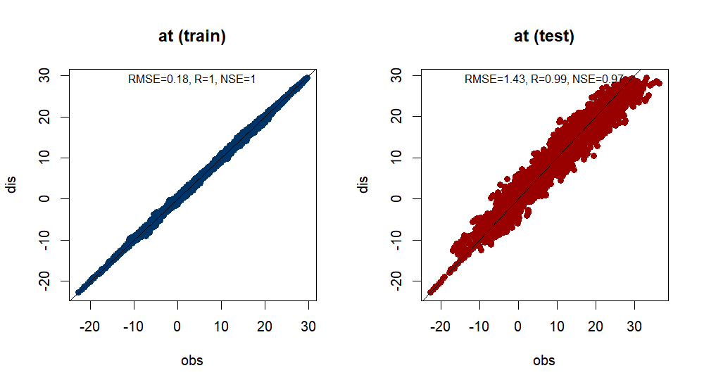
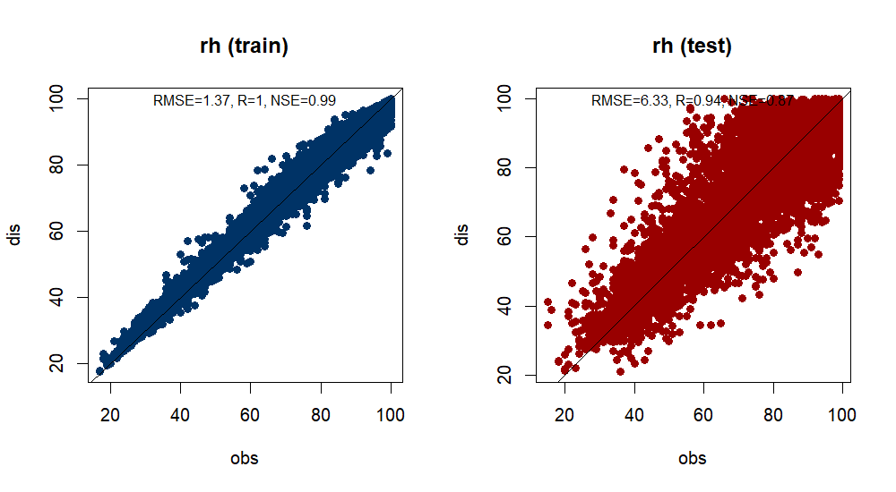
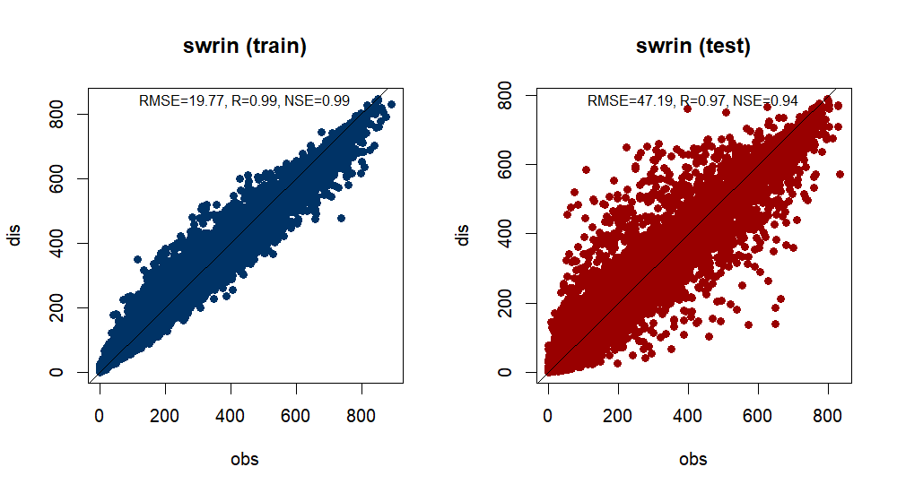
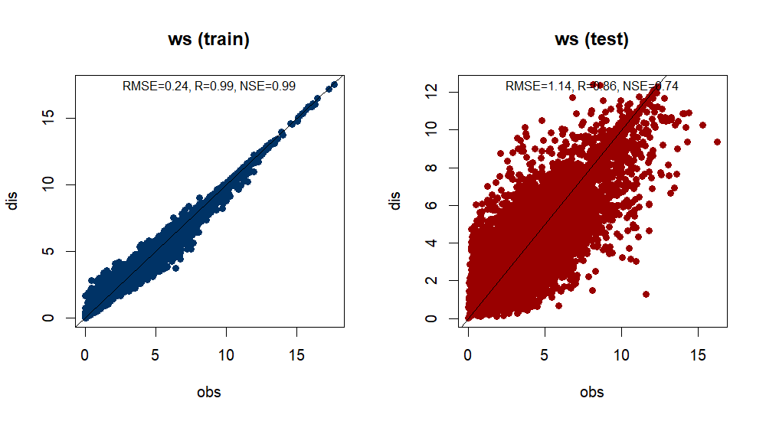
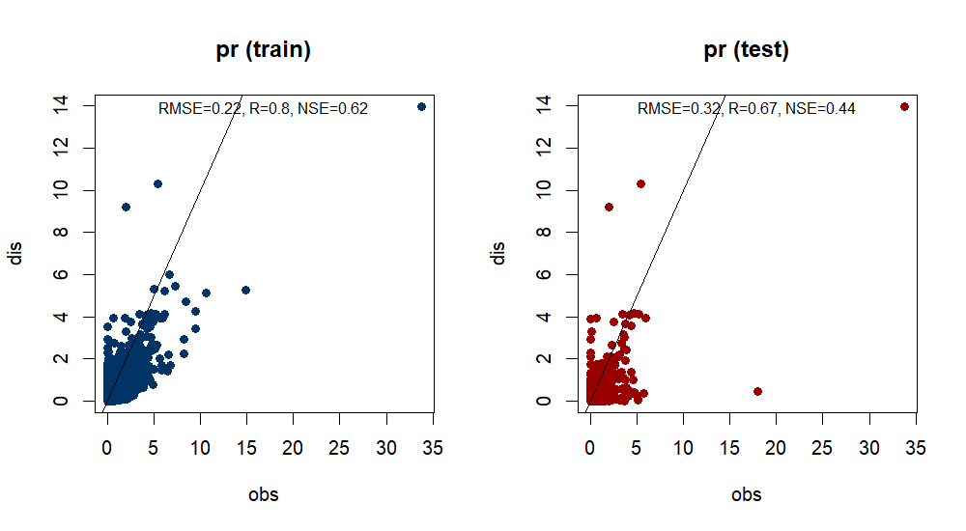
Method 1: (GRNN-based approach, following Ayala et al., 2020 https://doi.org/10.5194/hess-24-3311-2020

Slide 4
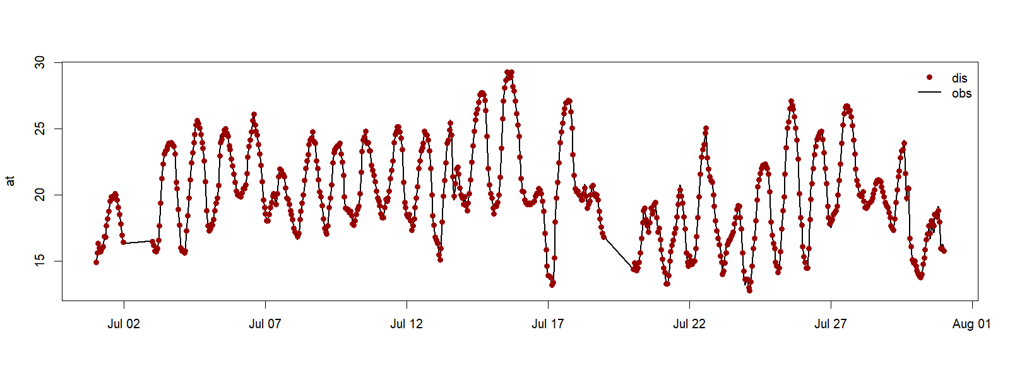
Method 1: (GRNN-based approach, following Ayala et al., 2020 https://doi.org/10.5194/hess-24-3311-2020
Notes:
July 2021

Slide 5
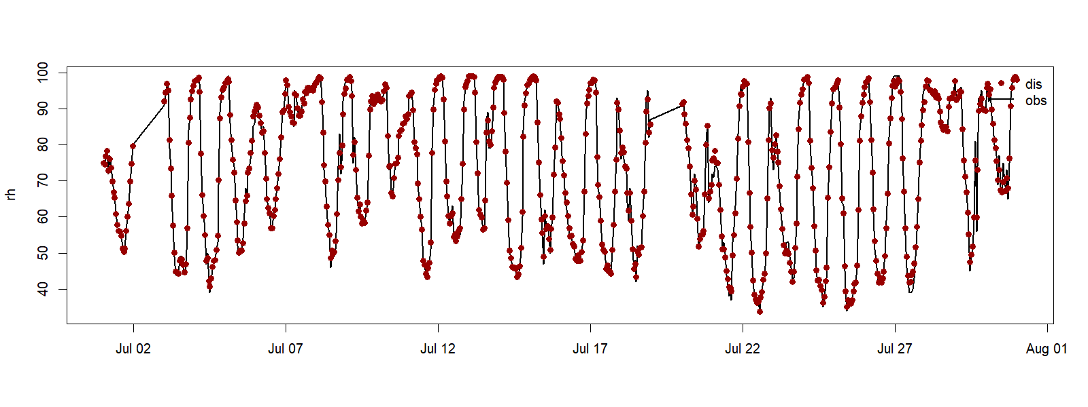
Method 1: (GRNN-based approach, following Ayala et al., 2020 https://doi.org/10.5194/hess-24-3311-2020
Notes:
July 2021

Slide 6
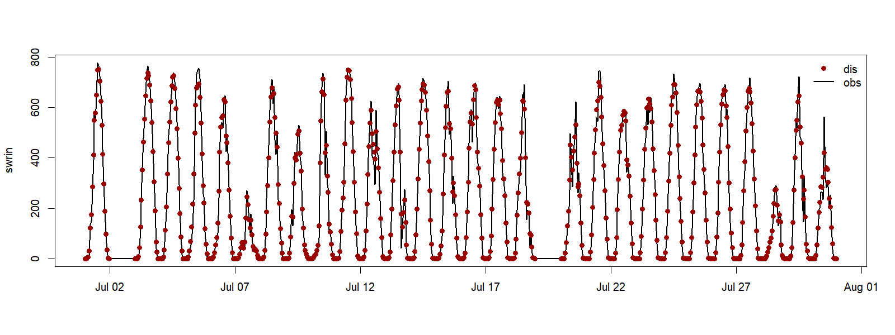
Method 1: (GRNN-based approach, following Ayala et al., 2020 https://doi.org/10.5194/hess-24-3311-2020
Notes:
July 2021

Slide 7
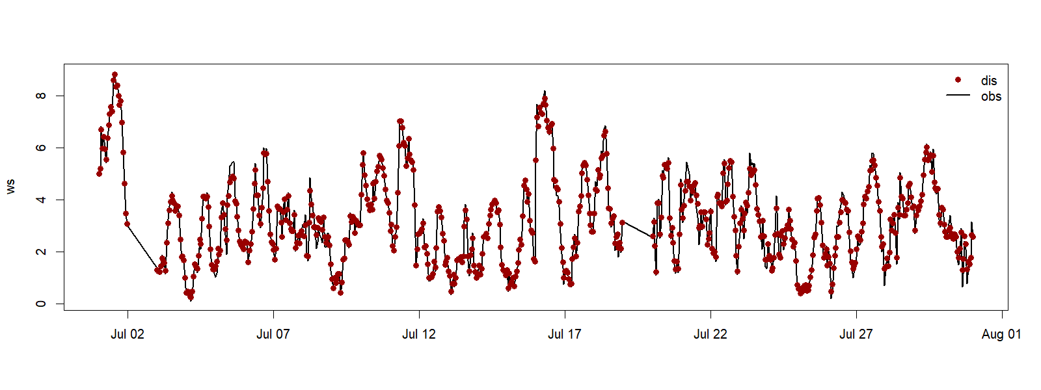
Method 1: (GRNN-based approach, following Ayala et al., 2020 https://doi.org/10.5194/hess-24-3311-2020
Notes:
July 2021

Slide 8
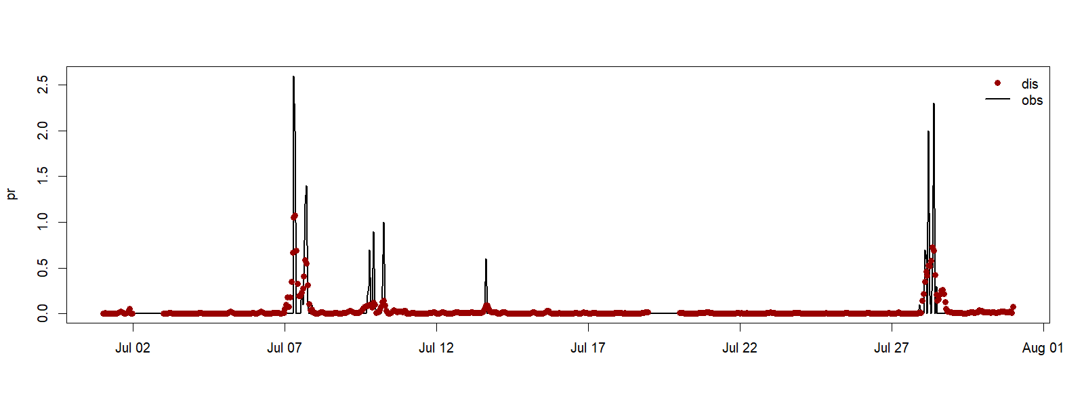
Method 1: (GRNN-based approach, following Ayala et al., 2020 https://doi.org/10.5194/hess-24-3311-2020
Notes:
July 2021

Slide 9
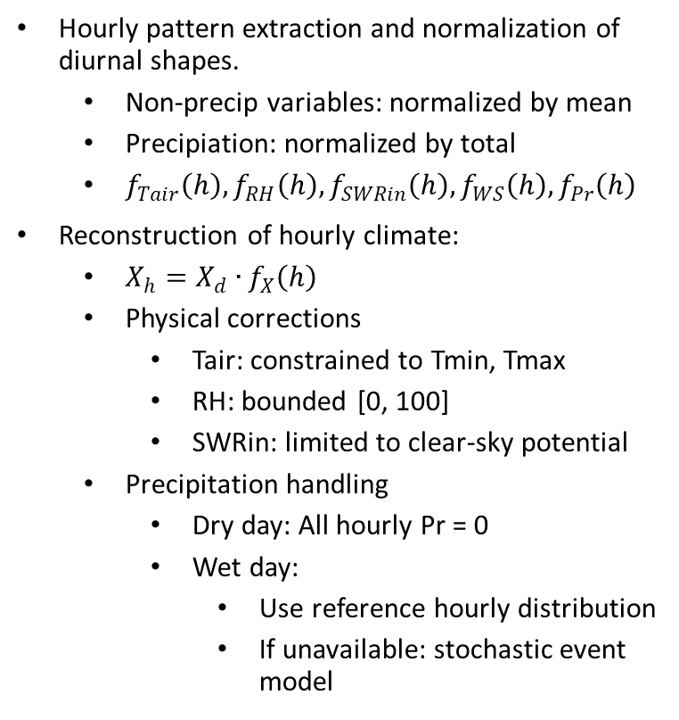
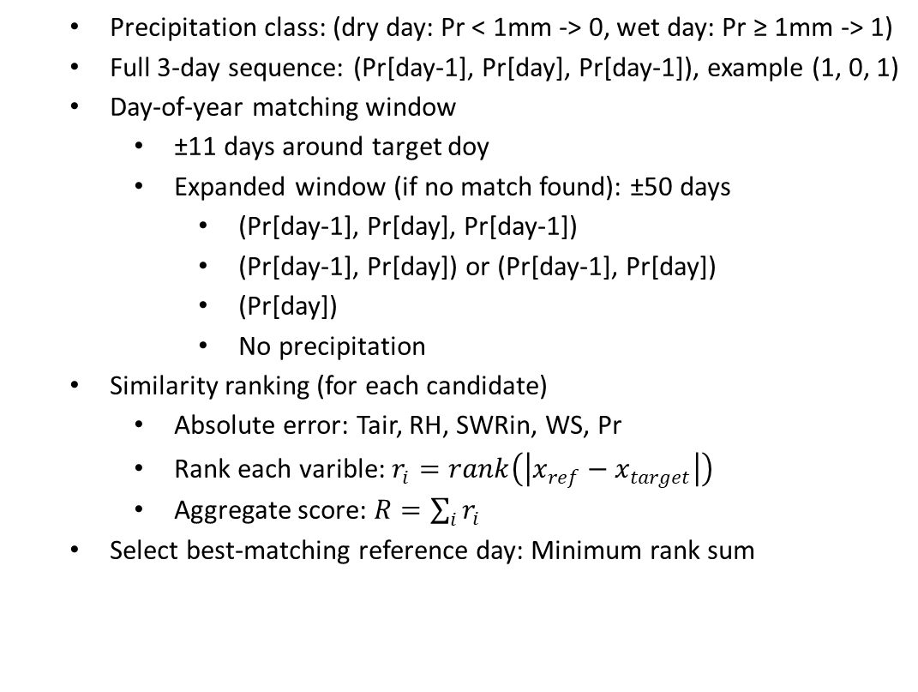
Method 2 (Teddy tool, following Zabel et al., 2023 https://doi.org/10.5194/gmd-16-5383-2023)
  Precipitation class: (dry day: Pr < 1mm -> 0, wet day: Pr ≥ 1mm -> 1)
  Full 3-day sequence: (Pr[day-1], Pr[day], Pr[day-1]), example (1, 0, 1)
  Day-of-year matching window
    ±11 days around target doy
    Expanded window (if no match found): ±50 days
      (Pr[day-1], Pr[day], Pr[day-1])
      (Pr[day-1], Pr[day]) or (Pr[day-1], Pr[day])
      (Pr[day])
      No precipitation
  Similarity ranking (for each candidate)
    Absolute error: Tair, RH, SWRin, WS, Pr
    Rank each varible: $r_{i}=rank\left(\left|x_{ref}−x_{target}\right|\right)$
    Aggregate score: $R=\sum_{i}{r_{i}}$
  Select best-matching reference day: Minimum rank sum
Hourly pattern extraction and normalization of diurnal shapes.
  Non-precip variables: normalized by mean
  Precipiation: normalized by total
  $f_{Tair}\left(h\right),f_{RH}\left(h\right),f_{SWRin}\left(h\right),f_{WS}\left(h\right),f_{Pr}\left(h\right)$
Reconstruction of hourly climate:
  $X_{h}=X_{d}∙f_{X}\left(h\right)$
  Physical corrections
    Tair: constrained to Tmin, Tmax
    RH: bounded [0, 100]
    SWRin: limited to clear-sky potential
  Precipitation handling
    Dry day: All hourly Pr = 0
    Wet day:
      Use reference hourly distribution
      If unavailable: stochastic event model

Slide 10
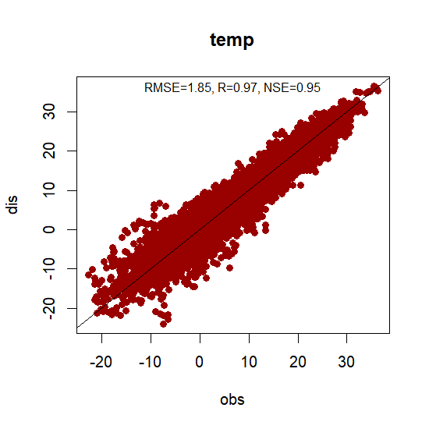
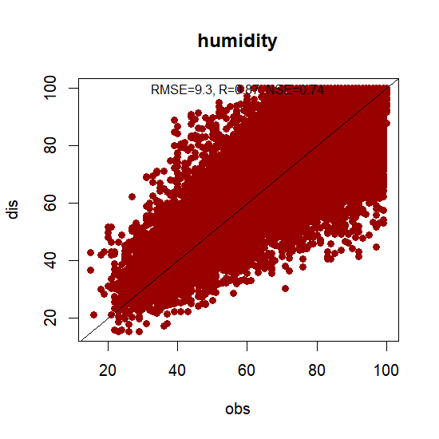
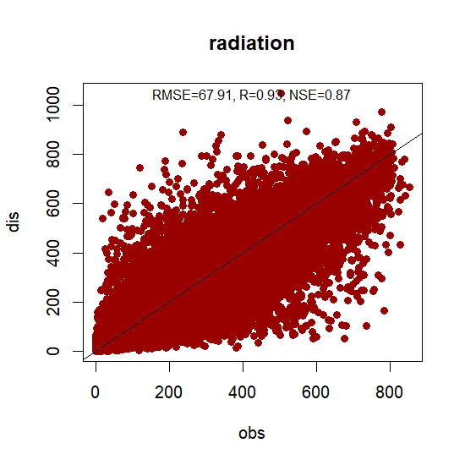
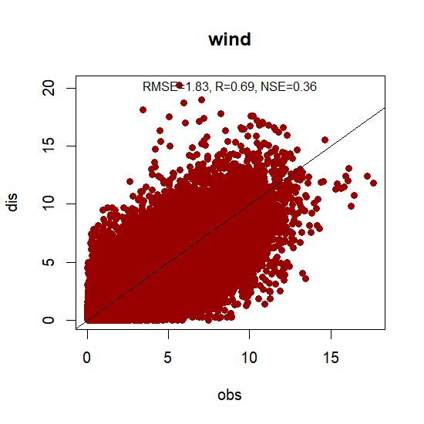
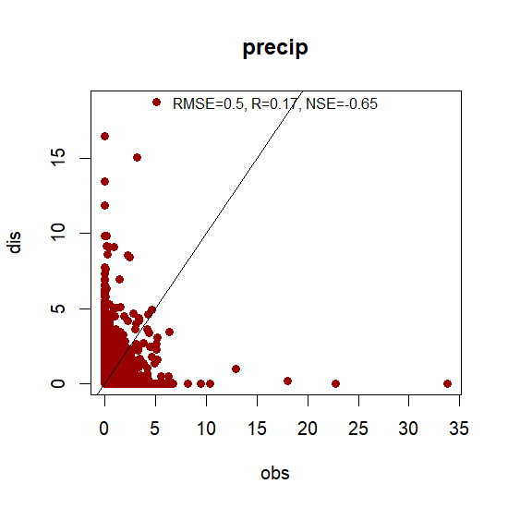
Method 2 (Teddy tool, following Zabel et al., 2023 https://doi.org/10.5194/gmd-16-5383-2023)
 | RMSE | R | NSE
Tair (°C) | 1.8456 | 0.9742 | 0.9483
RH (%) | 9.2965 | 0.8671 | 0.7439
SWRin (W/m2) | 67.9083 | 0.9335 | 0.8674
WS (m/s) | 1.8340 | 0.6916 | 0.3650
Pr (mm/h) | 0.5032 | 0.1664 | -0.6497

Slide 11
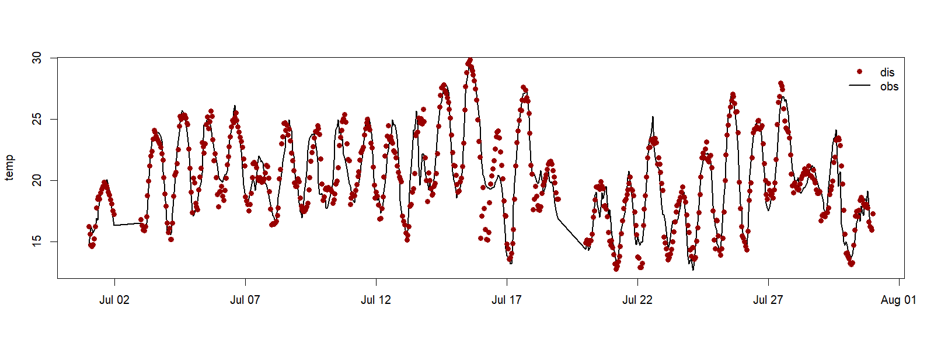
Method 2 (Teddy tool, following Zabel et al., 2023 https://doi.org/10.5194/gmd-16-5383-2023)
Notes:
July 2021

Slide 12
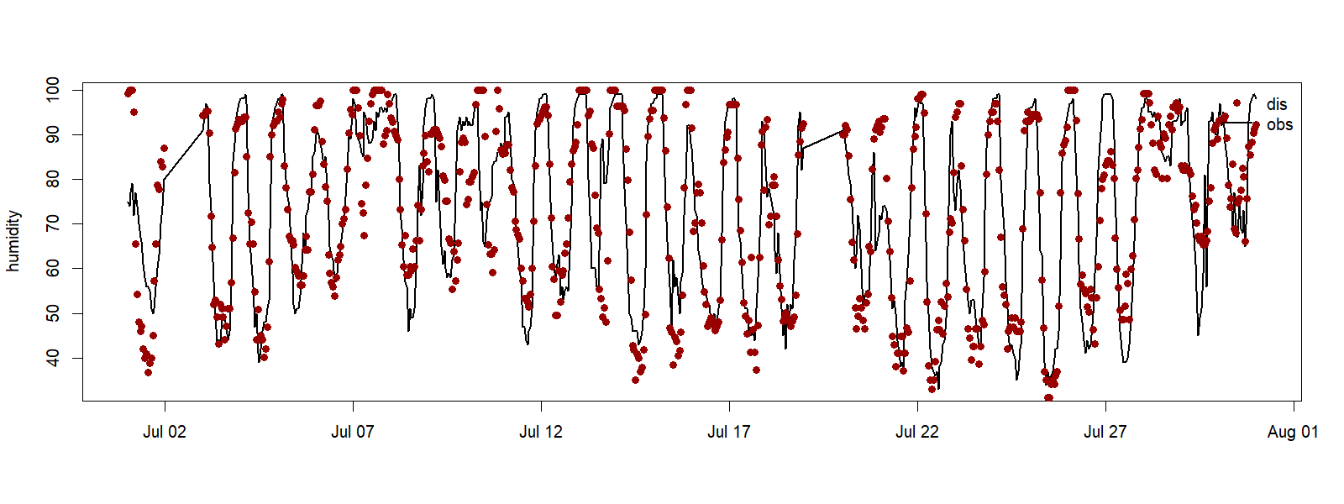
Method 2 (Teddy tool, following Zabel et al., 2023 https://doi.org/10.5194/gmd-16-5383-2023)
Notes:
July 2021

Slide 13
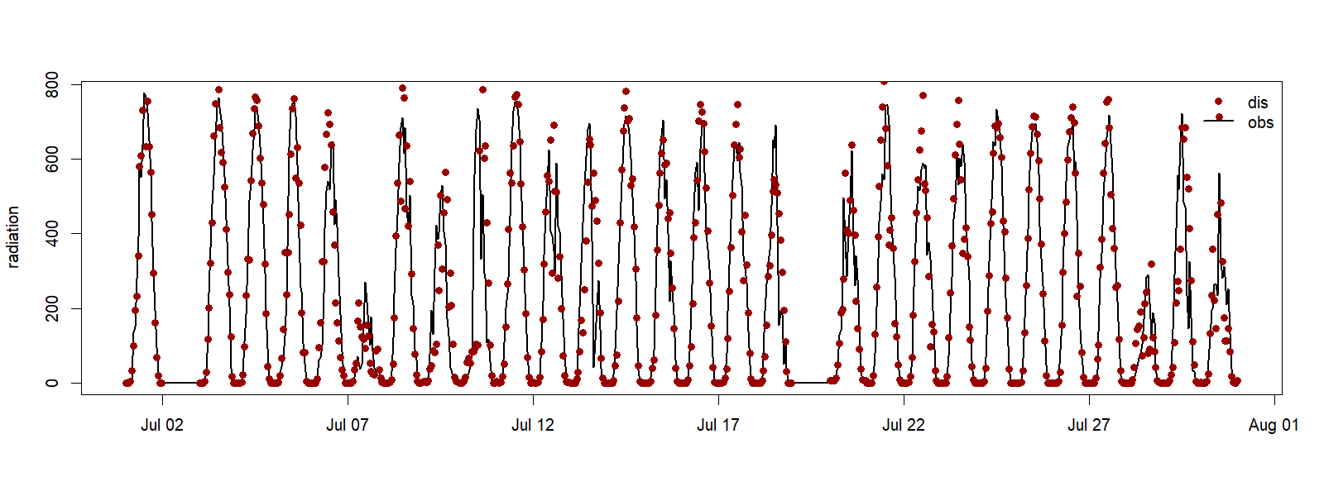
Method 2 (Teddy tool, following Zabel et al., 2023 https://doi.org/10.5194/gmd-16-5383-2023)
Notes:
July 2021

Slide 14
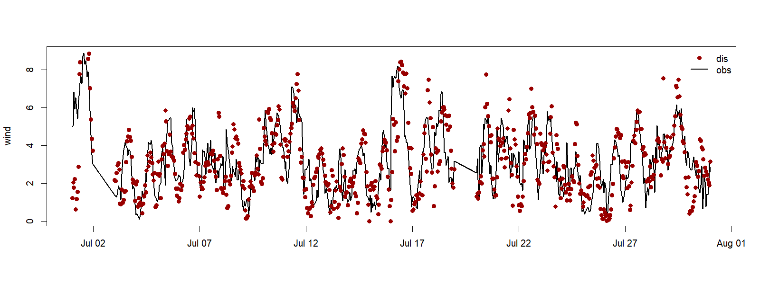
Method 2 (Teddy tool, following Zabel et al., 2023 https://doi.org/10.5194/gmd-16-5383-2023)
Notes:
July 2021

Slide 15
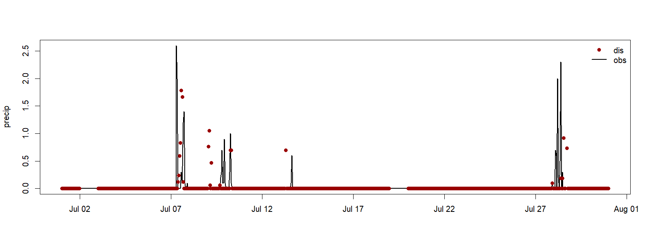
Method 2 (Teddy tool, following Zabel et al., 2023 https://doi.org/10.5194/gmd-16-5383-2023)
Notes:
July 2021

Slide 16

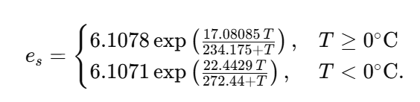

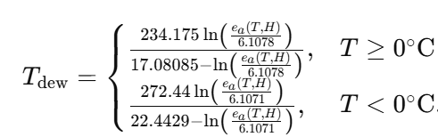
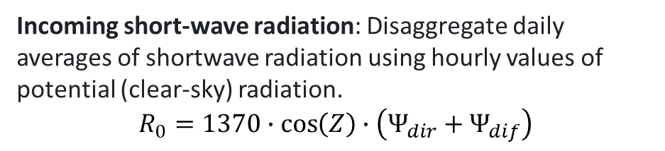
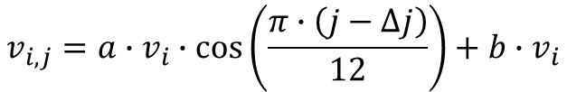
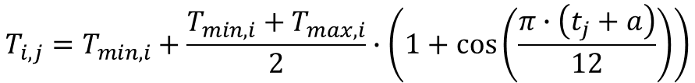
Method 3 (MELODIST, following Zabel et al., 2023 https://doi.org/10.5194/gmd-16-5383-2023)
 |  | RMSE | R | NSE
Tair (°C) | Cal | 1.7117 | 0.9318 | 0.9587
 | Val | 1.7786 | 0.9438 | 0.9544
RH (%) | Cal | 15.2817 | 0.5147 | 0.2037
 | Val | 16.1444 | 0.5575 | 0.2652
SWRin (W/m2) | Cal | 53.7937 | 0.9571 | 0.9160
 | Val | 51.9207 | 0.9605 | 0.9225
WS (m/s) | Cal | 1.3933 | 0.7954 | 0.6326
 | Val | 1.3579 | 0.8078 | 0.6525
Pr (mm/h) | Cal | 0.4556 | 0.1939 | -0.5063
 | Val | 0.4721 | 0.2435 | -0.4530
Incoming short-wave radiation: Disaggregate daily averages of shortwave radiation using hourly values of potential (clear-sky) radiation.
$$R_{0}=1370∙\cos\left(Z\right)∙\left(Ψ_{dir}+Ψ_{dif}\right)$$
Relative humidity
Air temperature
$$T_{i,j}=T_{min,i}+\frac{T_{min,i}+T_{max,i}}{2}∙\left(1+\cos\left(\frac{π∙\left(t_{j}+a\right)}{12}\right)\right)$$
Wind speed
$$v_{i,j}=a∙v_{i}∙\cos\left(\frac{π∙\left(j−∆j\right)}{12}\right)+b∙v_{i}$$
Precipitation: Probabilistic cascade model
Notes:
For T, a=temporal difference between solar noon and the occurrence of the maximum temperature
For v, a=amplitud ocefficient: controls how stron the oscillation is, b=baseline scaling factor: controls the average level of the velocity relative to vi, Δj= when wind speed peak.
For R0, Z=solar zenith (depende on time and latitude), $Ψ_{dir}$ and${ Ψ}_{dif}$ direct and diffuse radiation scaling values
For precipitation: the model splits rainfall into smaller time periods. It uses patterns learned from real data. From this data, it knows things like:
sometimes rain falls mostly in one short period,
sometimes it is spread more evenly,
sometimes one time step gets all the rain, and the next gets none.
These patterns are turned into probabilities and weights. Then, during disaggregation, the model randomly chooses how to split the rain based on those probabilities.

Slide 17
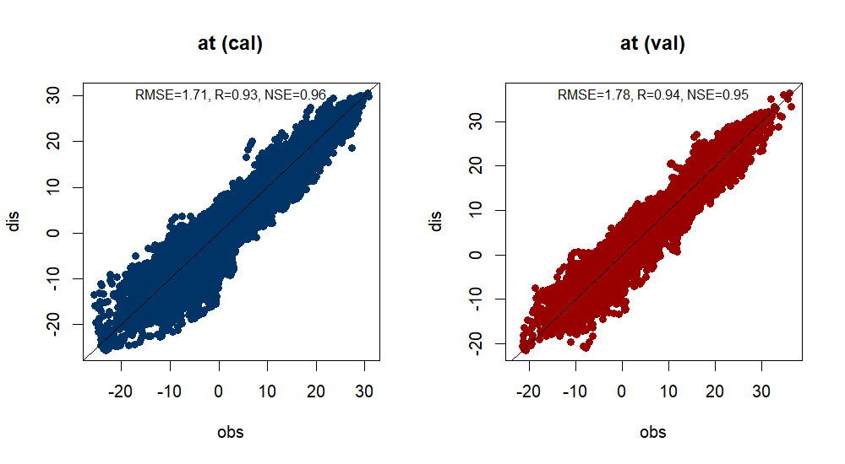
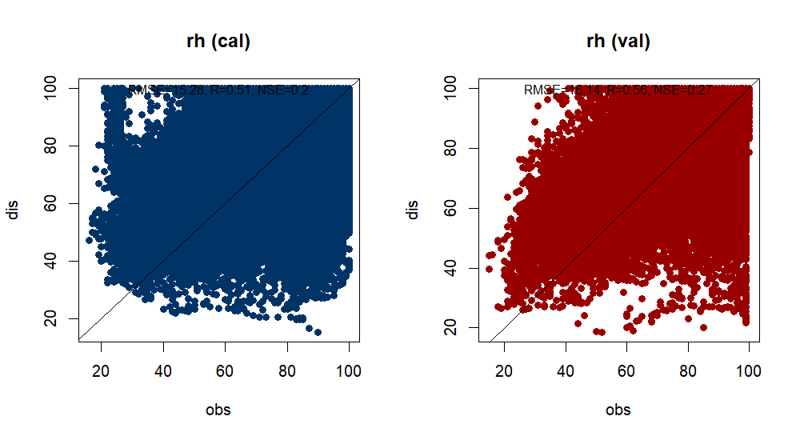
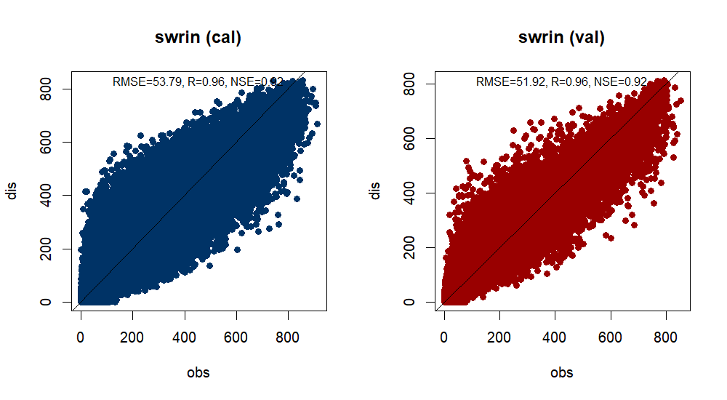
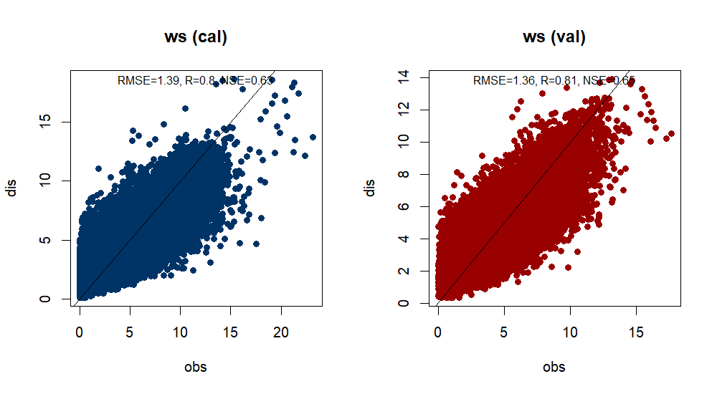
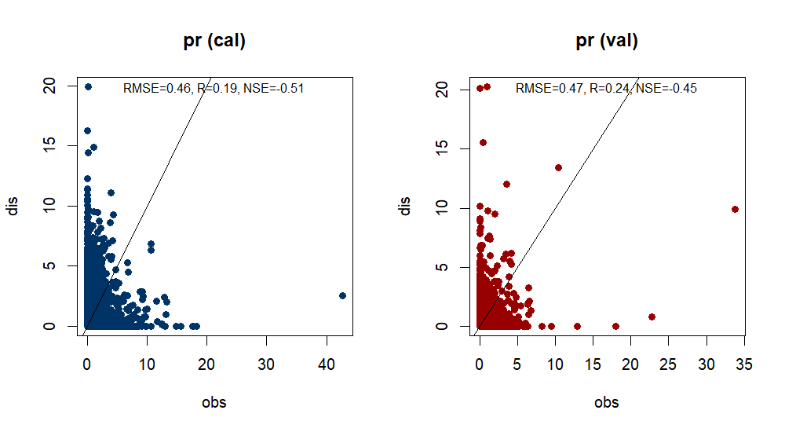
Method 3 (MELODIST, following Zabel et al., 2023 https://doi.org/10.5194/gmd-16-5383-2023)

Slide 18
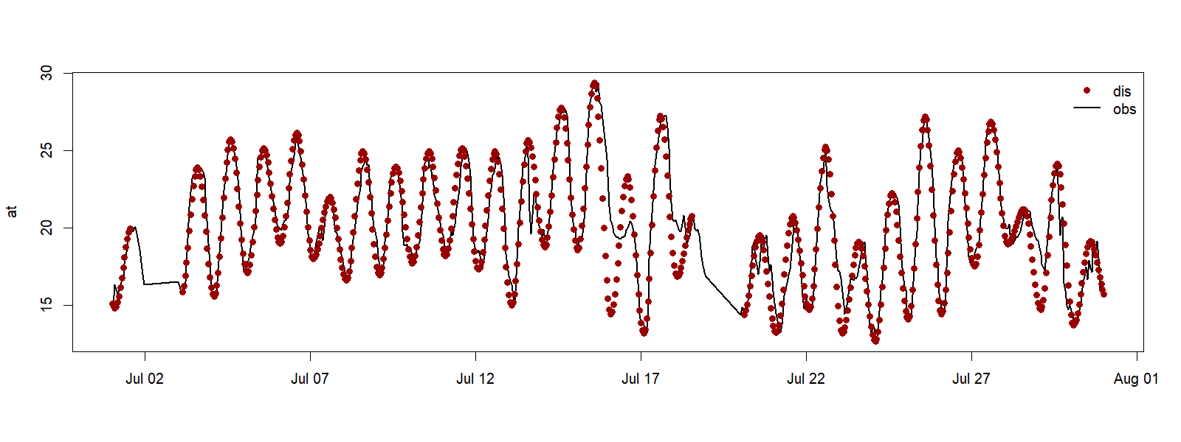
Method 3 (MELODIST, following Zabel et al., 2023 https://doi.org/10.5194/gmd-16-5383-2023)
Notes:
July 2021

Slide 19
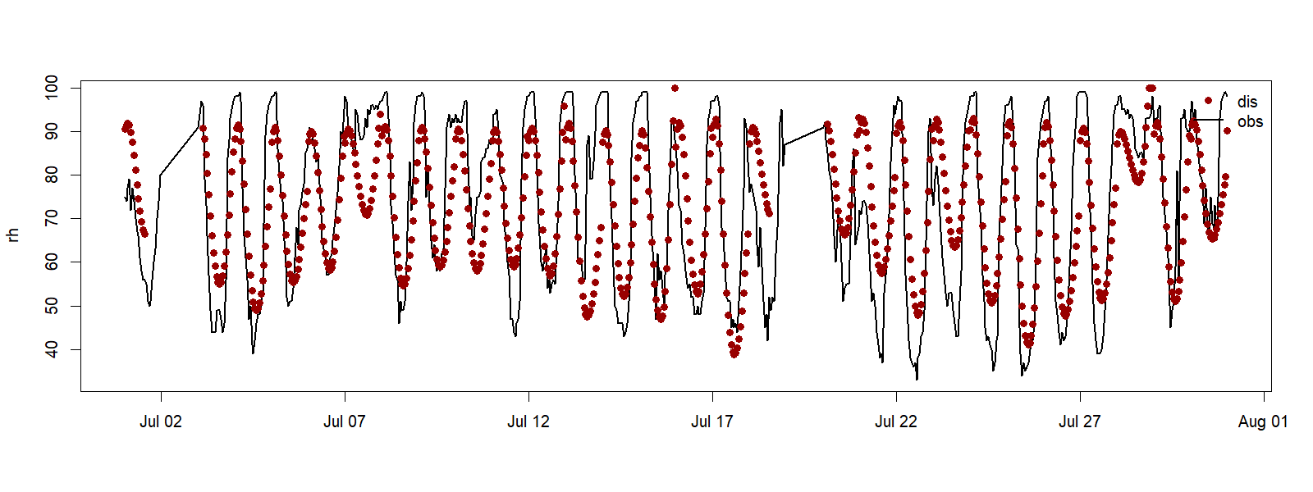
Method 3 (MELODIST, following Zabel et al., 2023 https://doi.org/10.5194/gmd-16-5383-2023)
Notes:
July 2021

Slide 20
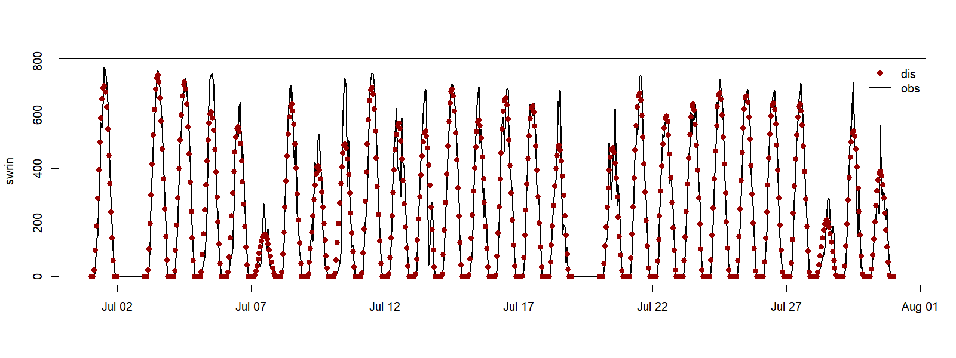
Method 3 (MELODIST, following Zabel et al., 2023 https://doi.org/10.5194/gmd-16-5383-2023)
Notes:
July 2021

Slide 21
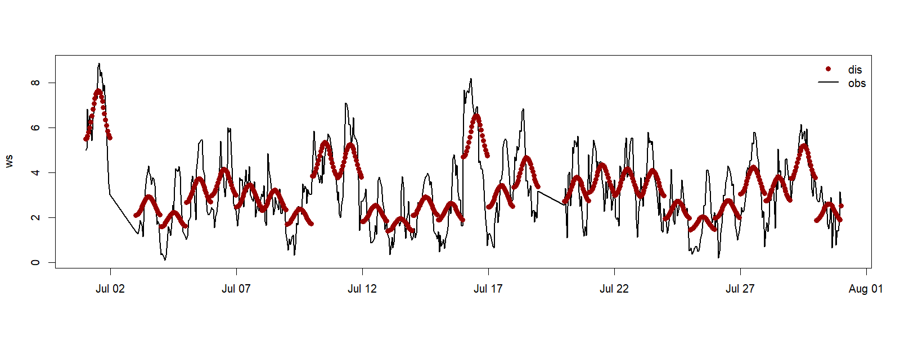
Method 3 (MELODIST, following Zabel et al., 2023 https://doi.org/10.5194/gmd-16-5383-2023)
Notes:
July 2021

Slide 22
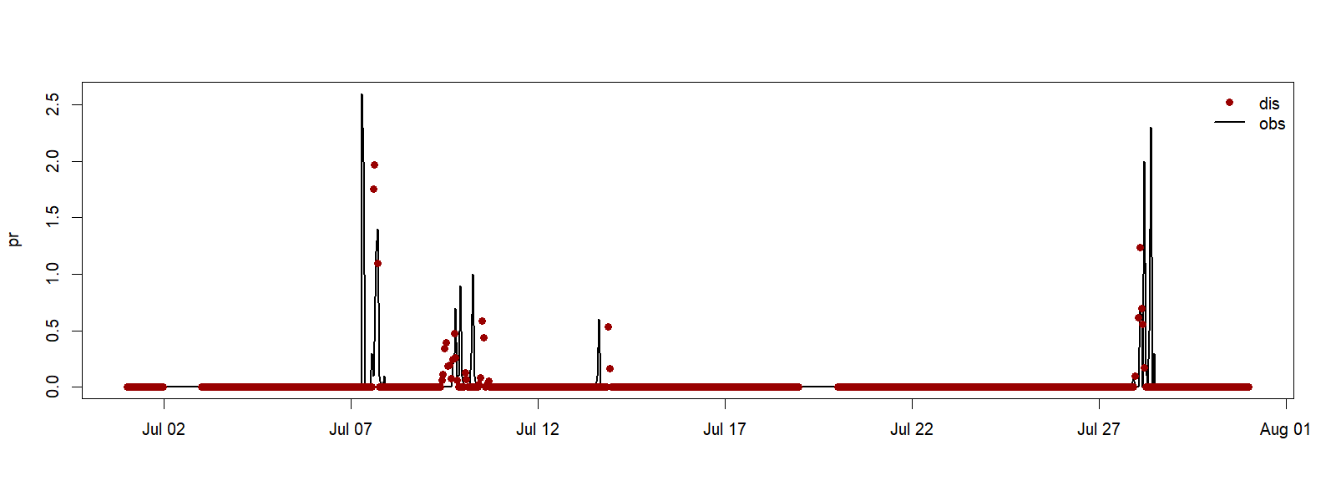
Method 3 (MELODIST, following Zabel et al., 2023 https://doi.org/10.5194/gmd-16-5383-2023)
Notes:
July 2021

